Slide 1

Taught By:
Daniel Opoku (Ph.D.)
EE 288 (ELECTRICAL) MEASUREMENT
& INSTRUMENTATION
CONTACT
c/o:
Address: Department of Electrical Engineering
KNUST, Kumasi, Ghana
E-mail: dopoku.coe@knust.edu.gh
Phone: 0553604143
Office: Opposite COE Department (Temp)
Semester 2, 2016/2017

Slide 2
Sources of Error
The outputs of measuring errors are not without errors.
Measuring errors can be reduced but cannot be eliminated entirely
Magnitude can be minimized by good measurement system design and Appropriate Analysis and processing of measurement data.
Noise can be divided into
Those occurring during measurement
Those occurring during transmission of the measured signal,
Those resulting from combining the output of different measurement instruments
We will consider the former in this section.

Slide 3
Sources of Error
It is important to reduce errors to minimum possible level and then to quantify the maximum remaining error that may exist in any instrument output reading.
There is a further complication that the final output from a measurement system is calculated by combining together two or more measurements of separate physical variables.
In this case, special consideration must also be given to determining how the calculated error levels in each separate measurement should be combined to give the best estimate of the most likely error magnitude in the calculated output quantity.
Errors arising during the measurement process can be divided into two groups, known as systematic errors and random errors.

Slide 4
Sources of Error [Sources of Systematic Error]
Systematic Errors: Errors due to inaccuracies in observation or measurement.
These errors have non-zero means so that their impact is not reduced by averaging observations.
One-sided error in the measurement (They average to either positive or negative errors).

Slide 5
Sources of Error [Sources of Systematic Error]
Main sources of systematic error in the output of measuring instruments
Disturbance of the measured system by the act of measurement
Effect of environmental disturbances, often called modifying inputs
Changes in characteristics due to wear in instrument components over a period of time
Resistance of connecting leads

Slide 6
Sources of Error [System Disturbance due to Measurement]
Disturbance of the measured system by the act of measurement
Measuring the temperature of a beaker of hot water using mercury-in-glass thermometer at room temperature.
Introduction of a cold mass into the hot water causes a reduction in temperature through heat transfer.
Though reduction is may be too small to detect by the instrument, it is finite.
This is a clear case of measuring process disturbing the system and altering the physical value being measured.
This happens in all measuring situations, magnitude of disturbance different for different situations.
An accurate understanding of the mechanisms of system disturbance is necessary for reducing the disturbance of the measuring system.

Slide 7
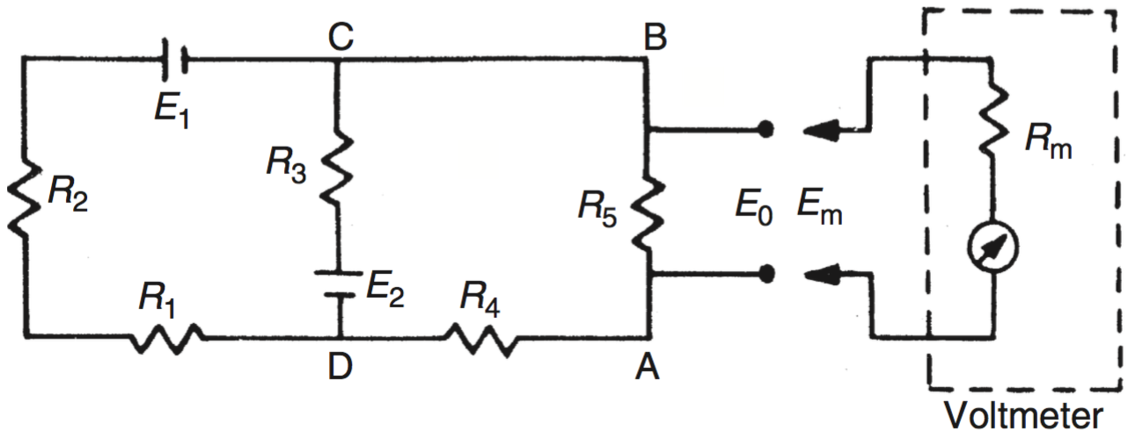
Sources of Error [System Disturbance due to Measurement]
In analyzing system disturbance during measurements in electric circuits, The ́venin’s theorem is often of great assistance.
Consider the measurement of the voltage across resistor Rs by a voltmeter with resistance Rm.
Rm acts as a shunt resistance across Rs, decreasing the resistance between points AB and so disturbing the circuit.
The voltage Em measured by the meter is not the value of the voltage E0 that existed prior to measurement.
The extent of the disturbance can be assessed by calculating the open-circuit voltage E0 and comparing it with Es.

Slide 8
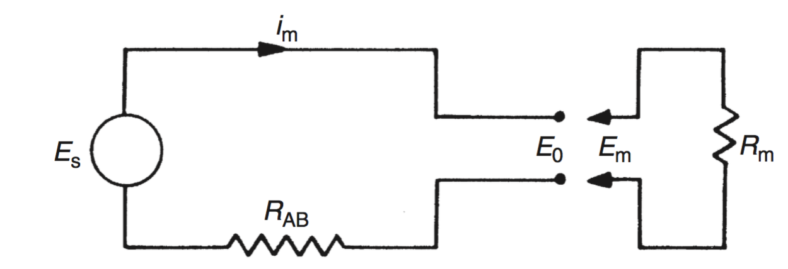
Sources of Error [System Disturbance due to Measurement]
The ́venin’s theorem allows the circuit of comprising two voltage sources and five resistors to be replaced by an equivalent circuit containing a single resistance and one voltage source.
Equivalent circuit by Th ́evenin’s theorem,
Circuit used to find the equivalent single.
Equivalent Resistance: All voltage sources are represented just by their internal resistance, which can be approximated to zero

Slide 9

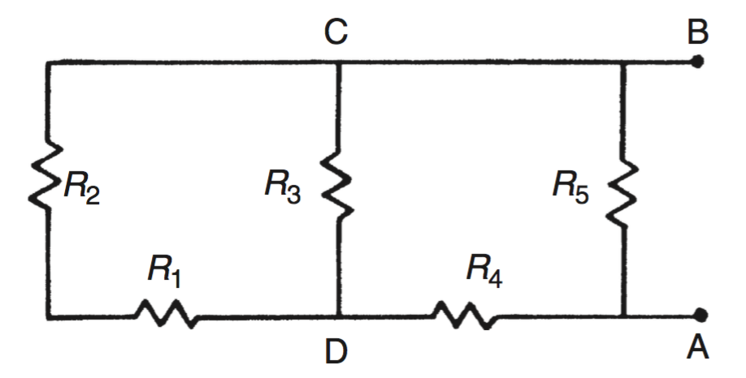


Sources of Error [System Disturbance due to Measurement]
From Applied,
Notes:
Computer Lecture 4 ended. Continue from herre.

Slide 10
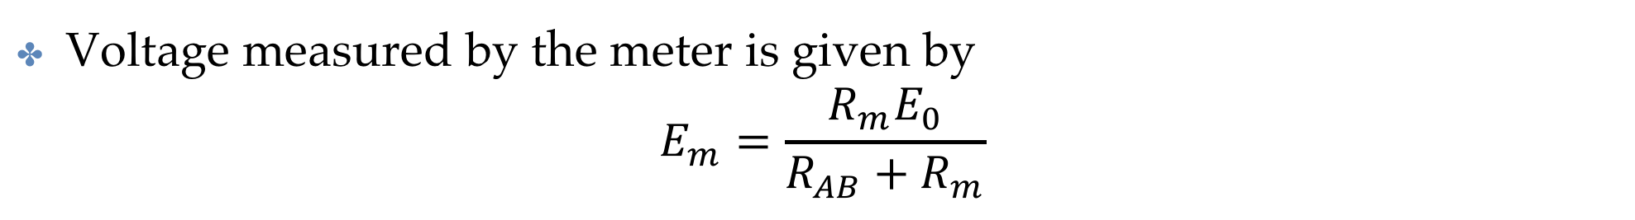
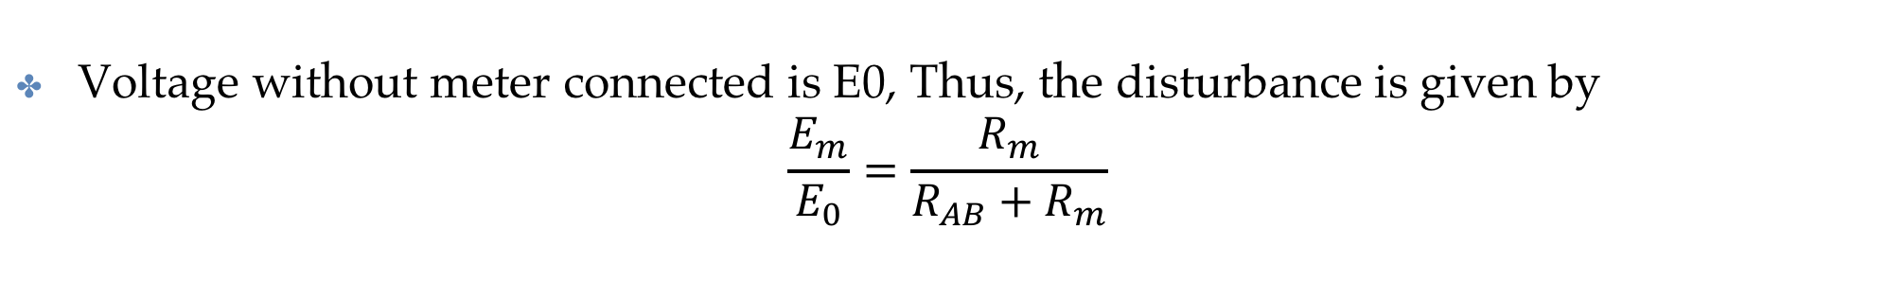

Sources of Error [System Disturbance due to Measurement]
Current flowing with Measuring Instrument in place is given by
$$I=\frac{E_{0}}{R_{AB}+R_{m}}$$
Voltage measured by the meter is given by
$$E_{m}=\frac{R_{m}E_{0}}{R_{AB}+R_{m}}$$
Voltage without meter connected is E0, Thus, the disturbance is given by
$$\frac{E_{m}}{E_{0}}=\frac{R_{m}}{R_{AB}+R_{m}}$$
So in order to reduce the disturbance, the value of Rm should be made as big as possible. Limit as Rm approaches infinity is Unity.

Slide 11
Sources of Error [System Disturbance due to Measurement]
This highlights the the constraints that exist when practical attempts are made to achieve a high internal resistance in the design of a moving-coil voltmeter.
Such an instrument consists of a coil carrying a pointer mounted in a fixed magnetic field. Current through the coil interacts with flux and cause deflection.
To increase the resistance, increase number of turns
Increase number of turns
Use a material with higher resistivity.
Both Decrease the current through the coil and hence magnetic torque and thus limited deflection is achieved.
Thus the sensitive of the instrument is decreased

Slide 12
Sources of Error [System Disturbance due to Measurement]
This can be minimized by choosing spring with small spring constant but this also reduce the ruggedness of the instrument.
Also demands better pivot design to reduce friction.
Thus any attempt to improve the performance of an instrument in one respect generally decreases the performance in some other aspect.
Passive instruments such as the type of voltmeter mentioned suffers from these and is often the reason for the use of alternative active instruments such as digital voltmeters, where the inclusion of auxiliary power improves performance greatly.

Slide 13
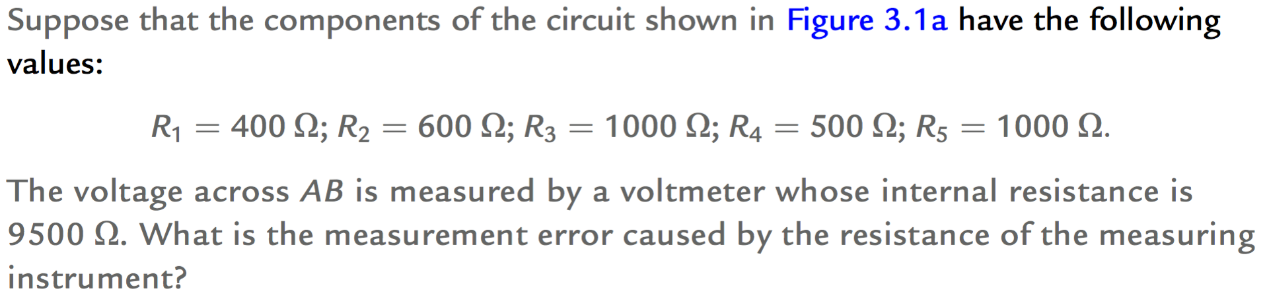
Sources of Error [System Disturbance due to Measurement]

Slide 14
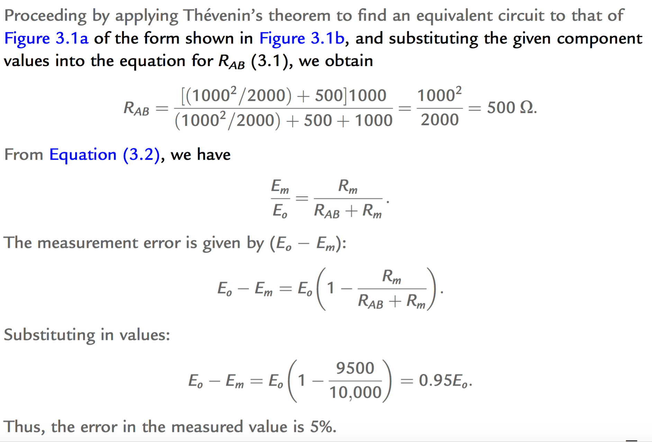
Sources of Error [System Disturbance due to Measurement]

Slide 15
[Errors due to Environmental Inputs]
The static and dynamic characteristics specified for measuring instruments are only valid for particular environmental conditions (e.g., of temperature and pressure)
Also known as modifying inputs
Away from the specified calibration conditions, the characteristics of measuring instruments vary to some extent and cause measurement errors.
The magnitude of this environment-induced variation is quantified by sensitivity drift and zero drift captured on the data sheet of the instrument.
Its difficult to differentiate the how much of the measurement is contributed by the modifying inputs and how much from the measured variable.

Slide 16
[Errors due to Environmental Inputs]
A box weighs 0.1 kg when empty contains either a mouse (0.5kg) and or a rat(0.9Kg). Weighting on a bathroom scale gives the total weight as 1.0kg. What does that mean?
Nothing! Because the weight indicated might be
(a) a 0.9 kg rat in the box (real input)
(b) an empty box with a 0.9 kg bias on the scale due to a temperature change (environmental input)
(c) a 0.5 kg mouse in the box together with a 0.4 kg bias
Thus, the magnitude of any environmental input must be measured before the value of the measured quantity (the real input) can be determined from the output reading of an instrument.

Slide 17
[Errors due to Environmental Inputs]
In Practical applications, very difficult to avoid environmental inputs
It is difficult or impractical to control the environmental conditions.
System designers reduce susceptibility of measuring instruments to environmental inputs
OR, quantifying the effects of environmental inputs and correcting for them in the instrument output reading.

Slide 18
[Wear in Instrument Components]
Systematic errors can frequently develop over a period of time because of wear in instrument components.
Recalibration often provides a full solution to this problem.

Slide 19
[Connecting Leads]
Disturbance from the connections of the instruments also adds to errors.
Connecting Leads in Electrical Connections
Connection Pipes in Pneumatic or Hydraulically actuated systems
Care must be taken in the choice of the lead.
Adequate cross-section to reduce resistance and heating
Should be screened from electrical and magnetic fields that can introduce noise.
Where screening is not possible, routing must be carefully planned.

Slide 20
[Reduction of Systematic Errors]
The prerequisite for the reduction of systematic errors is a complete analysis of the measurement system that identifies all sources of error.
Simple faults within a system,
such as bent meter needles
poor cabling practices,
can usually be rectified readily and inexpensively once they have been identified.
However, other error sources require more detailed analysis and treatment.

Slide 21
[Reduction of Systematic Errors]
Ways of reducing systematic Errors include
Careful Instrument Design
Calibration
Method of Opposing Inputs
High-Gain Feedback
Signal Filtering
Manual Correction of Output Reading
Intelligent Instruments
NB: Students are required to go and read the detail from Section 3.3 of the reference book.

Slide 22
[Sources and Treatment of Random Errors ]
Random errors in measurements are caused by unpredictable variations in the measurement system.
Sources include:
measurements taken by human observation of an analogue meter, especially where this involves interpolation between scale points.
electrical noise.
random environmental changes, for example, sudden draught of air.
NOTE: Students are advised to read Section 3.5 to section 3.11 for more information about random noises.

Slide 23
THANK YOU
ANY QUESTION?

